Slide 1
Reasons to Live

Slide 2
Name One Reason to Live

Slide 3
Who Am I And Why Do I care About This

Slide 4
Disclaimer

Slide 5
When I say Suicide….What Comes to Mind

Slide 6
Our own anxiety

Slide 7
And….We do not have a crystal Ball (At Least One that Works)

Slide 8
One more thing before we talk about suicide…

Slide 9
Suicide; A Few Statistics

Slide 10
Looking Deeper at the Statistics

Slide 12
Suicidal Ideation

Slide 13
Classic Spectrum of “Risk”

Slide 14
Another Look------Spectrum of Risk (Joiner, 2017)

Slide 15
It’s more complicated………….

Slide 16
Spectrum

Slide 17
Structured Assessment Tools

Slide 18
Risk Factors for Suicidal Behaviors

Slide 19
Other Signs of Suicidal Ideation

Slide 20
Protective Factors

Slide 21
Interpersonal Theory of Suicide

Slide 22
Hope Vs Inescapable, Lonely Pain

Slide 23
Hope and Hopelessness

Slide 24
Questions to Assess Hope

Slide 25
Locus of Pain

Slide 26
Questions to Assess Locus of Pain

Slide 27
Meaning Vs. Feeling a Burden

Slide 28
Self-Hate; A Feeling of Being a Burden; Helplessness

Slide 29
“I don’t care if I live or die”-Parasuicidal Risk Taking

Slide 30
Substance Abuse: A Major Risk Factor

Slide 31
Self-Harm, Eating Disorders

Slide 32
On Suicidal Threats without Intent to Die----

Slide 33
Suicidal Ideation as a Means of Communication

Slide 34
Mood Disorders

Slide 35
Psychosis

Slide 36
Questions to Assess Suicide Risk in a Person who Hears Voices

Slide 37
More on Risk Assessment in Psychosis

Slide 38
Borderline Personality Disorder

Slide 39
PTSD

Slide 40
Demographics of Suicide Completion

Slide 41
Gender

Slide 42
Suicide in Men

Slide 43
Which Age Group Has the Highest Rate of Suicide?

Slide 44
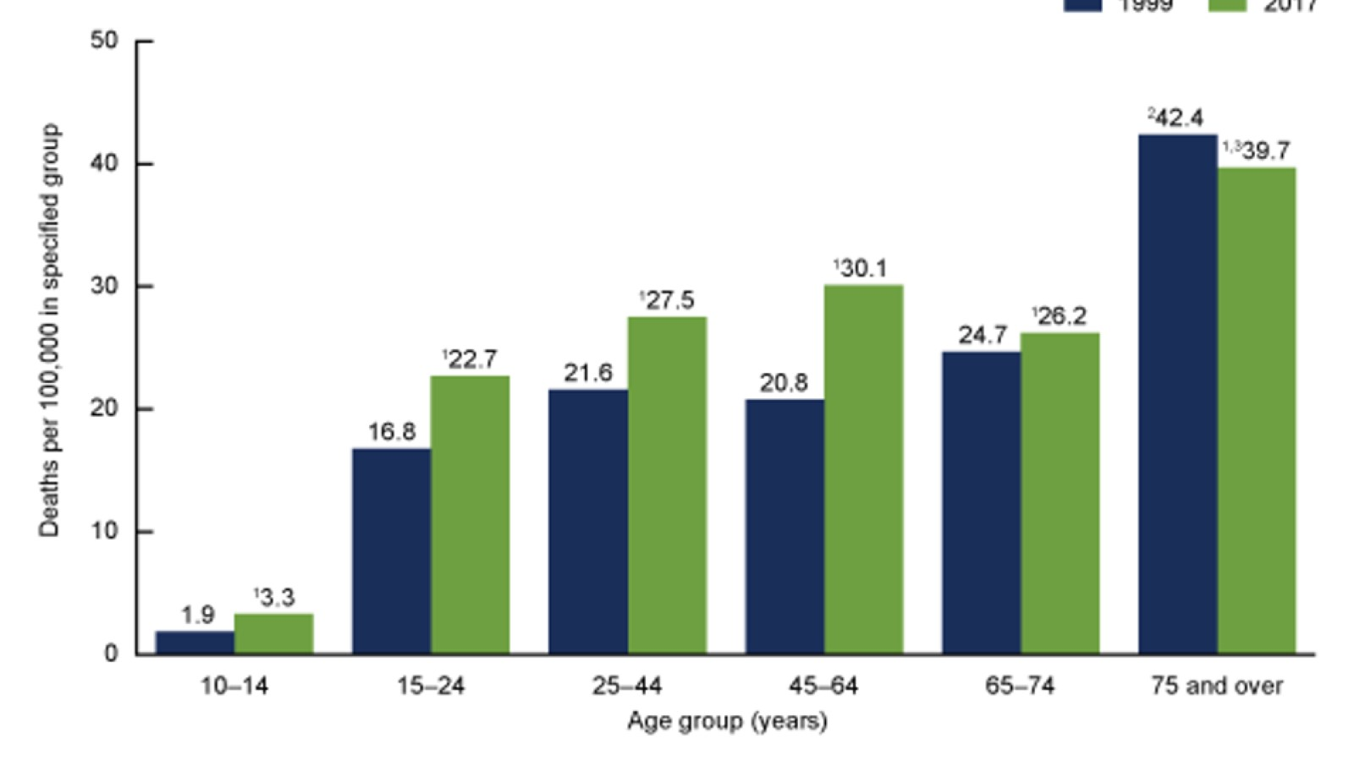

Slide 45
Suicide Among the Elderly

Slide 46
What was important to you when you were a Youth?

Slide 47
Suicide Among Adolescents

Slide 48
What would you do if you were invisible

Slide 49
Cyberbullying, Adolescents and Suicide

Slide 51
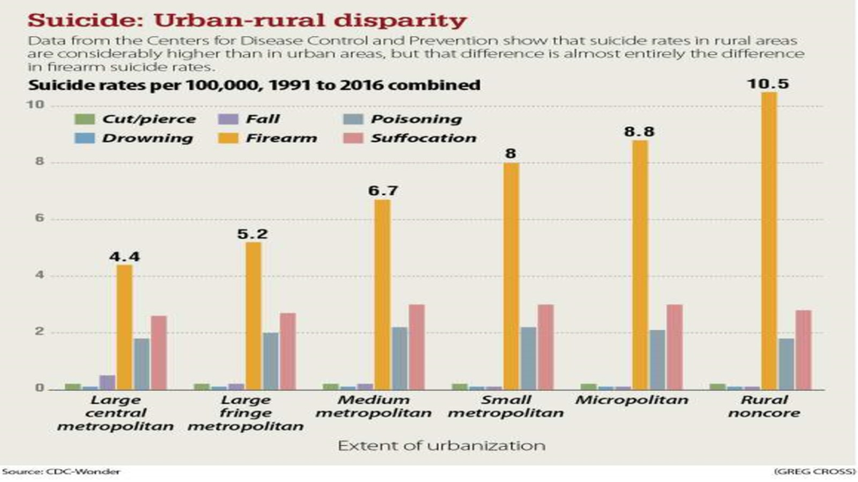

Slide 52
Having a Mental Health Condition

Slide 53
Basic Risk Factors

Slide 54
Some final thoughts on risk assessment

Slide 55
Gatekeepers

Slide 56
Why do we add to people’s pain?

Slide 57
Ways To Not Add To Pain

Slide 58
Interventions

Slide 59
Ways to Give Hope After an Attempt

Slide 60
Safety Planning

Slide 62
On Means………………..

Slide 63
Other Interventions (Once Safety is Established)

Slide 64
If all we are doing is cpr…..

Slide 65
Reasons for Living

Slide 66
Research on Reasons for Living……….

Slide 67
And it can be an ongoing conversation…….

Slide 68
Reasons for Living Inventory

Slide 69
Commitment to Life

Slide 70
More on Commitment to Life

Slide 71
Fighting Aloneness

Slide 72
A LIFE WORTH LIVING………………

Slide 73
Adding Colors to a Black and White Rainbow….

Slide 74
Self-Kindness as a defense against sense of burden/helplessness

Slide 75
Opening Self to Good Things Again

Slide 76
Radical Acceptance

Slide 77
Take Care of Your Self

Slide 78
People Survive This and Recover

Slide 79
Resources

Slide 80
Local Resources

Slide 81
References

